Slide 1

Google Fiber Internet Presentation
An in-depth analysis of how effectively the customer service team resolve customers requests
Presented By: Viet Pham

Slide 2
Table Of Contents:
Project’s overview
Data and analysis
Conclusions and recommendations
Dashboard reference

Slide 3
Project overview
The Google Fiber customer service team’s goal is to determine how often customers are calling customer support after their first inquiry. This will help leadership understand how effectively the team is able to answer customer questions the first time. The stakeholders also want insights about repeat caller volumes in different markets and the types of problems they represent
The team’s ultimate goal is to reduce call volume by increasing customer satisfaction and improving operational optimization

Slide 4

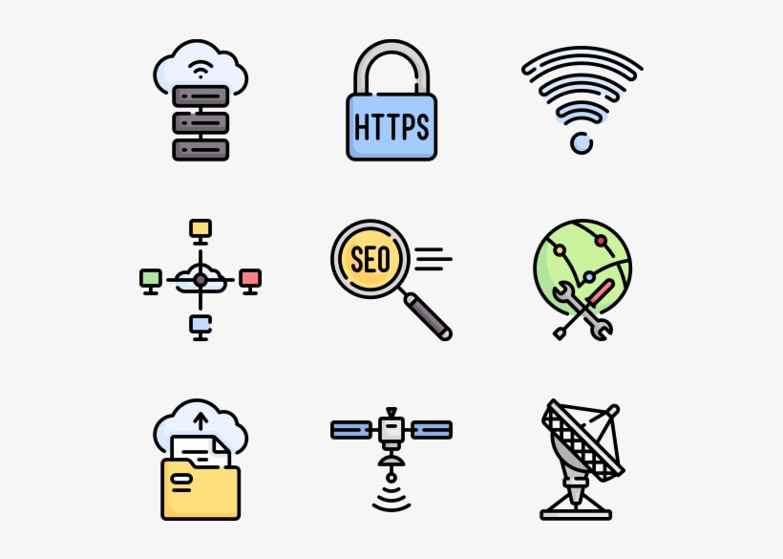

Dashboard Key insights:
How often customers are calling customer support after their first inquiry on different timescale
Trends in repeated calls in 3 different market cities
The types of customer issues that seem to generate more repeat calls

Slide 5
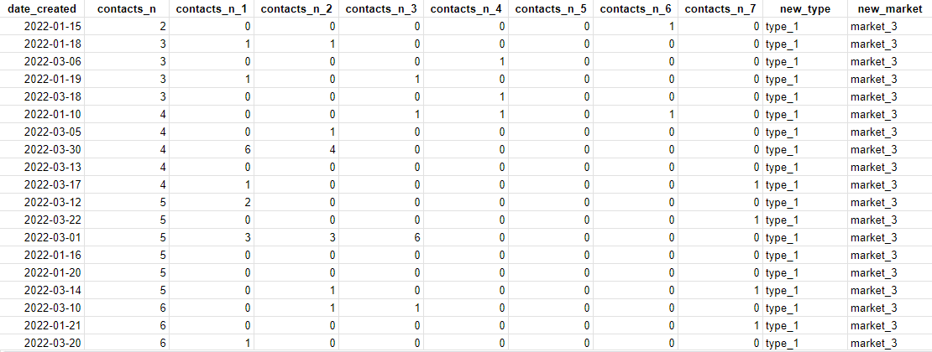
Dataset

Slide 6
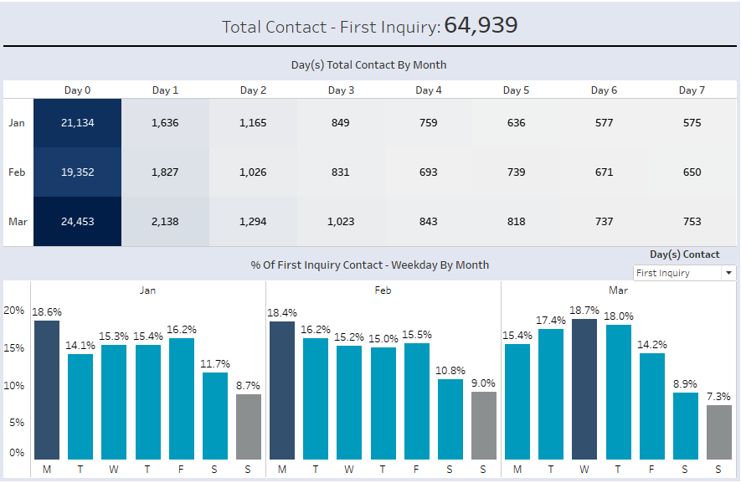
Customers repeated call trends
Significantly drop after the first initial contact from customers (Day 1: ~91% in calls resolution)

Slide 7
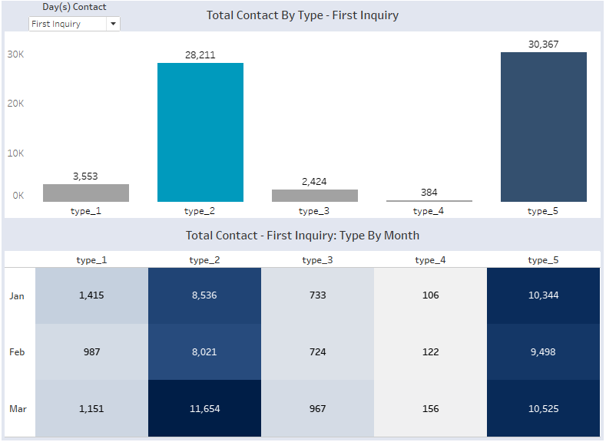
Types of customer issues
Internet & wifi
Technician troubleshooting
~90% in number of calls on the 1st inquiry
Type 2: technicians shortage, or complaints
Type 5: high need frequency on installing internet, or pain points (frequency wifi outage, disconnect)

Slide 8
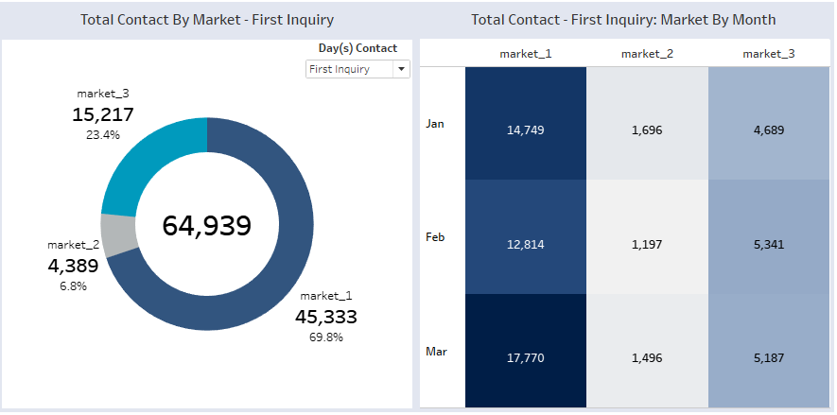
Repeat caller trends in the three different market cities
Market 1: urban area, with the high request frequency from the customers
The potential increasing from market 3

Slide 9
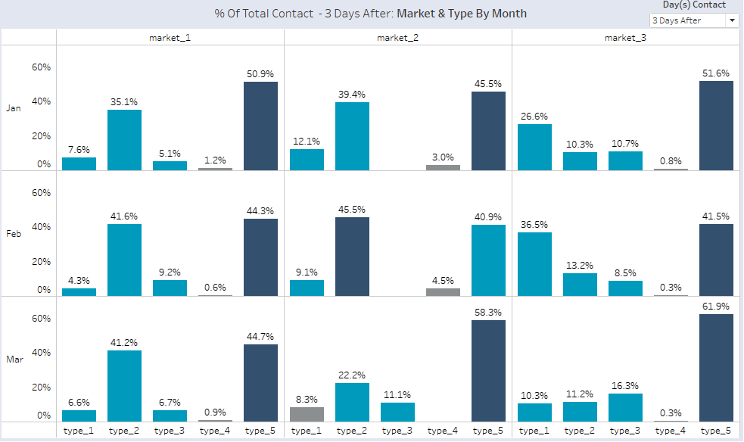
Call trends in market & type
The increasing repeated calls on type 1 or 3 in the market 3 after the first inquiry

Slide 10
Conclusions/Recommendations
Enhancing in training customer service team (target → reducing the repeated calls after the initial contact by 95% or above in the next quarter)
Recruit more technicians, or further train to technicians by holding training or live demonstration (monthly)
Address demands and fixing pain points; upgrade and improve our products to meet customers need
More support at market 1 (mobilizing more staff needed, training); having measures to decrease the potential increasing in repeated calls at market 3

Slide 11
THANK YOU!

Slide 12
Dashboard reference:
Fiber_ | Tableau Public

